Slide 1
Antigens and the Immune Response
Assist. Professor
Dr. Sinan Bahjat
M.B.Ch.B., M.Sc., F.I.B.M.S.

Slide 2
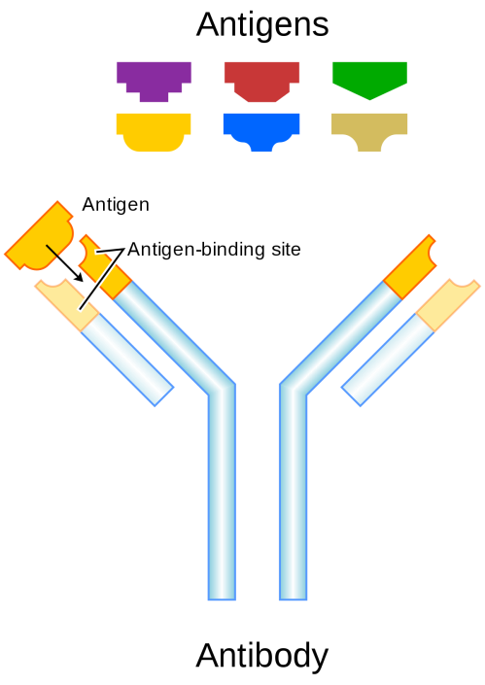
Antigens are molecules that react with antibodies, whereas immunogens are molecules that induce an immune response. In most cases, antigens are immunogens, and the terms are used interchangeably.

Slide 3
However, there are certain important exceptions (e.g., haptens). A hapten is a molecule that is not immunogenic by itself but can react with specific antibody.

Slide 4
Haptens are usually small molecules (MW is less than 10.000), but some high-molecular-weight nucleic acids are haptens as well. Many drugs (e.g., penicillins) are haptens, and the catechol in the plant oil that causes poison oak and poison ivy is a hapten.

Slide 5
Haptens are not immunogenic because they cannot activate helper T cells. The failure of haptens to activate is due to their inability to bind to Major Histocompatibility Complex (MHC) proteins; they cannot bind because they are not polypeptides and only polypeptides can be presented by MHC proteins.

Slide 6
Furthermore, haptens are univalent and therefore cannot activate B cells by themselves.

Slide 7
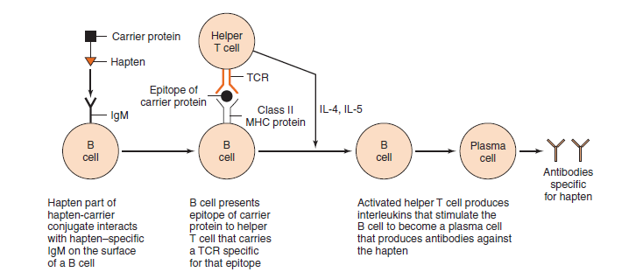
Although haptens cannot stimulate a primary or secondary response by themselves, they can do so when covalently bound to a “carrier” protein. In this process, the hapten interacts with an IgM receptor on the B cell and the hapten– carrier protein complex is internalized.

Slide 8
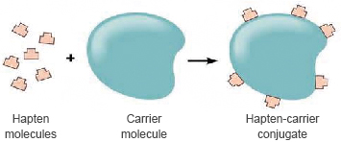
Haptens, such as drugs (e.g., penicillin) and poison oak oil, can interact with our immune system when it bind to our normal proteins, to which we are tolerant.

Slide 9
The hapten–protein combination now becomes immunogenic (i.e., the hapten modifies the protein sufficiently such that when the hapten–peptide combination is presented by the MHC protein, it is recognized as foreign).

Slide 10
Another medically important concept that is related to the hapten–carrier protein model is that of conjugate vaccines such as the pneumococcal and meningococcal vaccines and the vaccine against Haemophilus influenzae.

Slide 11
In these conjugate vaccines, the capsular polysaccharide is conjugated to a carrier protein. The capsular polysaccharide is not a hapten because it can induce IgM via the T-independent response. However, adding a carrier protein causes helper T cells to be involved, and large amounts of IgG are produced via the T-dependent response.

Slide 12
The features of molecules that determine immunogenicity are as follows:
Foreignness: molecules recognized as “Self” are not immunogenic.
Molecular size: molecules with molecular weight < 10.000 is considered as non-immunogenic or weakly immunogenic.
Chemical- structural complexity: A certain amount of chemical complexity is required.

Slide 13
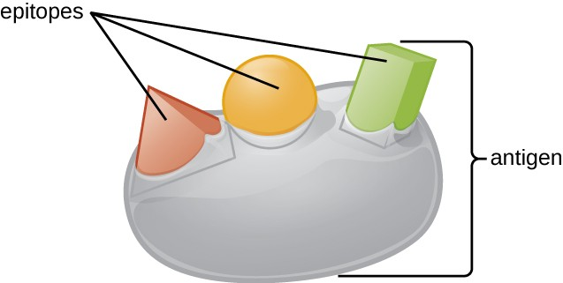
Antigenic determinants (Epitopes): they are small chemical groups on the antigen molecule that can elicit and react with antibody. An antigen can have one or more determinants (epitopes). Most antigens have many determinants (i.e., they are multivalent). In general, a determinant is roughly five amino acids or sugars in size.

Slide 14
Dosage, route and timing of antigen administration: These factors also affect immunogenicity.

Slide 15
Adjuvants

Slide 16
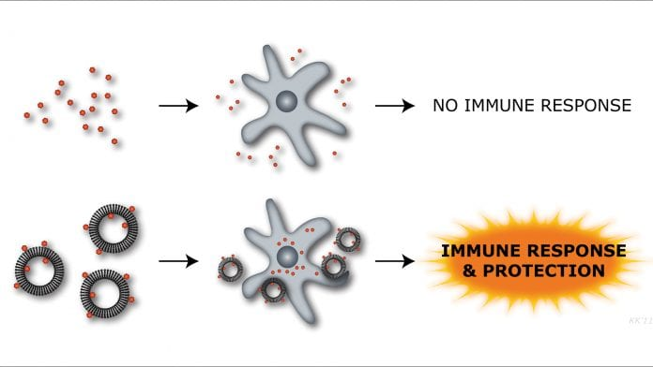
Adjuvants enhance the immune response to an immunogen. They are chemically unrelated to the immunogen and differ from a carrier protein because the adjuvant is not covalently bound to the immunogen, whereas the carrier protein is.

Slide 17
Adjuvants can act in a variety of ways:
Cause slow release of immunogen, thereby prolonging the stimulus.
Enhance uptake of immunogen by antigen-presenting cells.
Induce co-stimulatory molecules.
Stimulate Toll-like receptors on the surface of macrophages.

Slide 18
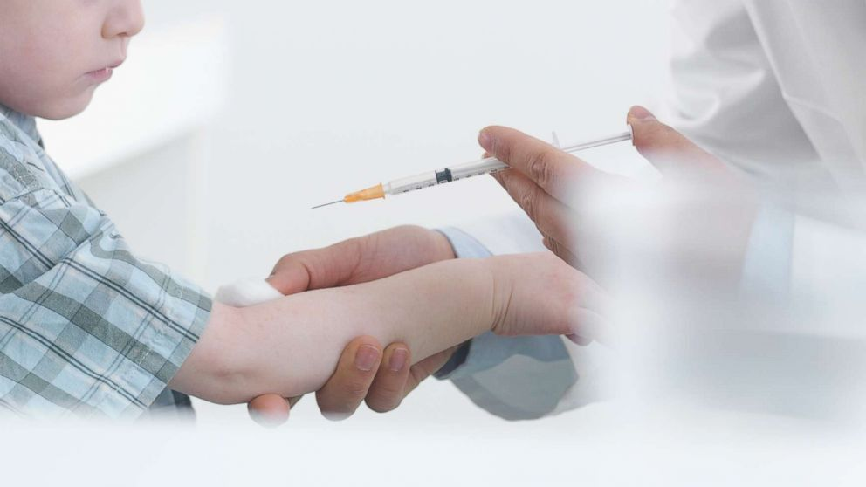
One of the important aspects of adjuvants usage in medical field is through its use in vaccine production for some types of vaccines (e.g. aluminum hydroxide and lipids) .

Slide 19
The Immune Response

Slide 20
Cell- mediated immunity and antibodies are both highly specific for the invading organism. The process by which these host defenses originate can be summarized by three actions:
Recognition of the foreign organism (i.e. antigen) by specific immune cells.
Activation of these immune cells to produce a specific response (e.g., antibodies).
Response that specifically targets the organism for destruction.

Slide 21
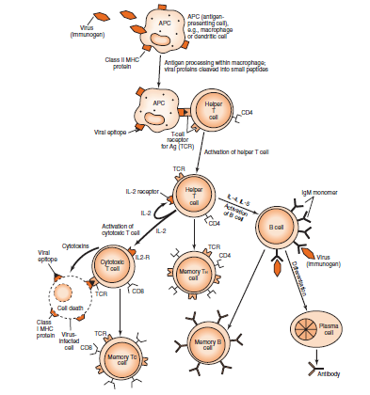

Slide 22
When a microorganism enters the body and engulfed by the macrophage, This microorganism is broken down, and fragments of it called antigens or epitopes appear on the surface of the macrophage in association with class II major histocompatibility complex (MHC) proteins.

Slide 23
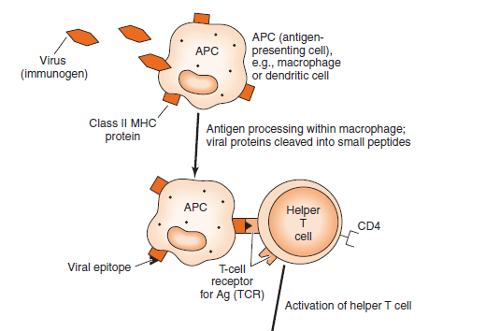
The antigen–class II MHC protein complex interacts with an antigen-specific receptor on the surface of a helper T lymphocyte.

Slide 24
Activation and clonal proliferation of this antigen-specific helper T cell occur as a result of the production of interleukins, the most important of which are interleukin-2 (T cell growth factor) and gamma interferon (activates macrophages).

Slide 25
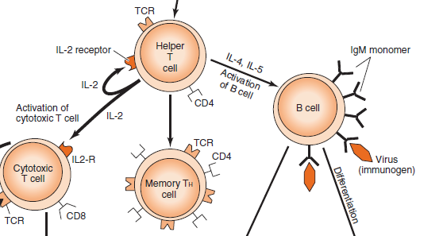

Slide 26
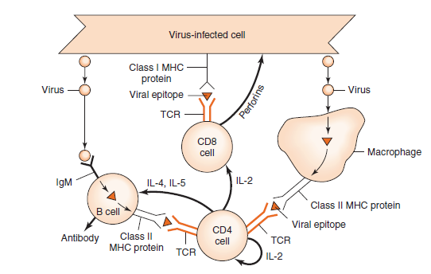
In case of viral infection, cellular mediated immunity (i.e. cytotoxic T cells) are activated against virus-infected cells after appearance of viral envelope glycoproteins on the surface of the infected cell in association with class I MHC proteins.

Slide 27
A cytotoxic T cell binds via its antigen-specific receptor to the viral antigen–class I MHC protein complex and is stimulated to grow into a clone of cells (by interleukin- 2 produced by helper T cells).

Slide 28
These cytotoxic T cells specifically kill the virus–infected cells by recognizing viral antigen–class I MHC protein complexes on the cell surface and releasing perforins that destroy the membrane of the infected cell.

Slide 29
The antibody-mediated immunity (antibody synthesis) typically involves the cooperation of three cells: antigen-presenting cells (e.g., dendritic cells and macrophages), helper T cells, and B cells.

Slide 30
After processing by an antigen-presenting cell, fragments of antigen appear on the surface of that cell in association with class II MHC proteins.

Slide 31
The antigen–class II MHC protein complex binds to receptors on the surface of a helper T cell specific for that antigen. This activates the helper T cells to produce interleukins such as interleukin-2 (IL-2), IL-4, and IL-5. These interleukins activate the B cell to produce antibodies specific for that antigen.

Slide 32
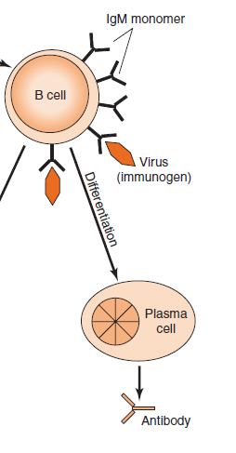
The activated B cell proliferates and then differentiates to form many plasma cells that secrete large amounts of immuno-globulins (antibodies).

Slide 33
Although antibody formation usually involves helper T cells, certain antigens (e.g., bacterial polysaccharides) can activate B cells directly, without the help of T cells, and are called T cell–independent antigens. In this T cell–independent response, only IgM is produced by B cells.

Slide 34
The B cells can perform two important functions during the induction process:
They recognize antigens with their surface IgM that acts as an antigen receptor.
They present epitopes to helper T cells in association with class II MHC proteins.

Slide 35
The IgM antigen receptor on the B cell can recognize not only foreign proteins but also carbohydrates, lipids, DNA, RNA, and other types of molecules. The class II MHC proteins of the B cell, however, can only present peptide fragments to the helper T cells.

Slide 36
Thank You

